Slide 1
Conceptualization and Applications of Blockchain

Slide 2
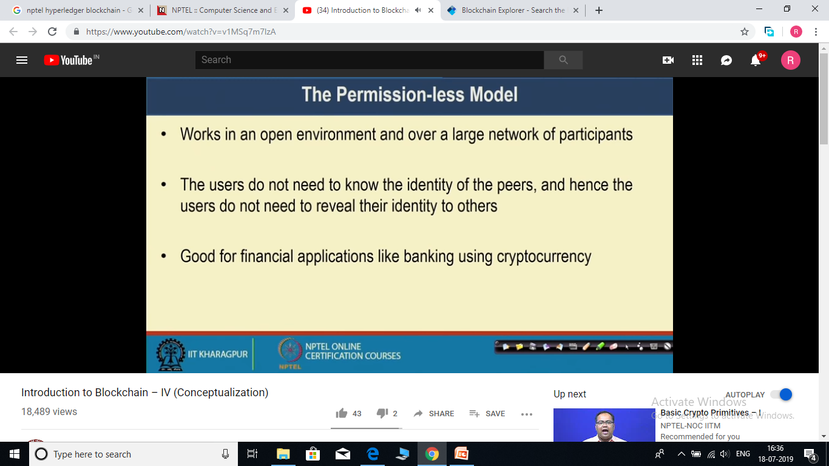

Slide 3
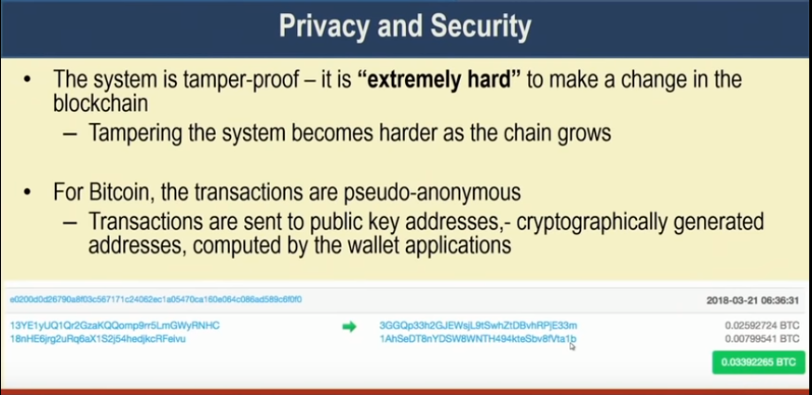
Transactions are pseudo anonymous -> you do not know the actual identities of sender and receiver but still cryptographically generated ids are visible. So you are still able to see the transaction.

Slide 4
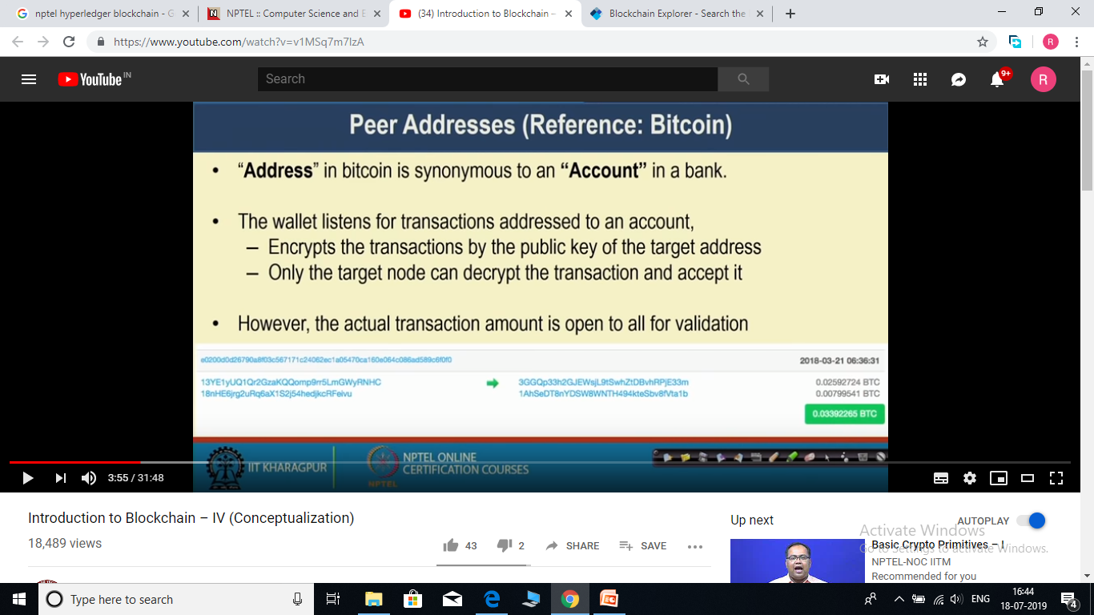

Slide 5
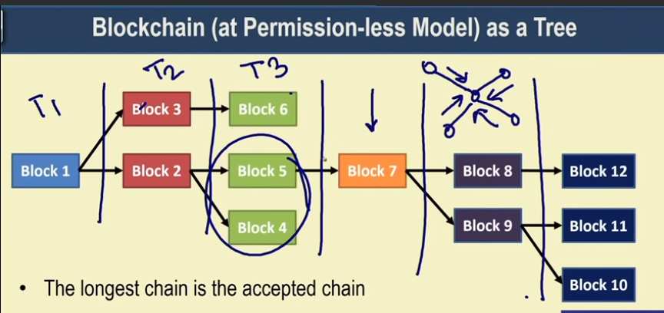
In blockchain n/w, multiple miner trying to mine the blocks at the same time, So there may be situation when multiple blocks are mined by the miners at nearly same time.
Let us suppose that, at time T2, a number of transactions come and two miners are able to mine 2 blocks at the same time ( i.e. T2). So both the miners will add the block to block 1.
Now lets suppose that at time T3, 3 blocks are mined and first miner use block3 as previous node and rest two miner use block 2 as previous block.
In blockchain n/w whenever we are adding a new block in blockchain, and that updated blockchain is broadcasted to all neighbours node. A neighbour can receive multiple blocks from peers and whenever this is the case , it accept the block with the longest blockchain.
If at the same time there are multiple blockchain of same length, then one of them is selected randomly.

Slide 6
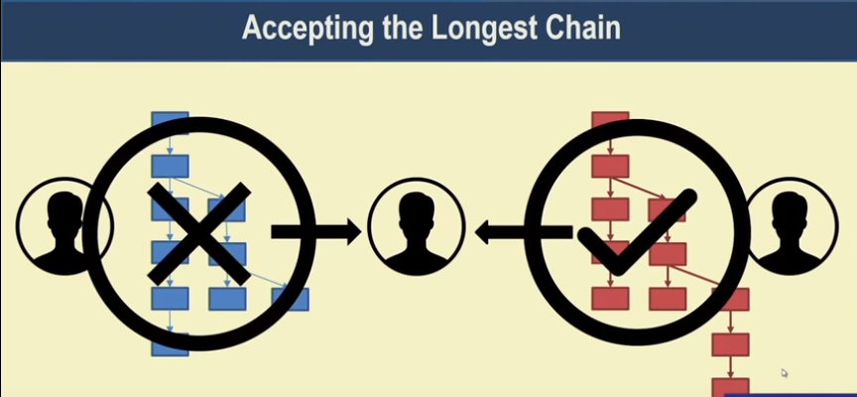
Whenever a node receive multiple chains, it always accept the longest chain.

Slide 7
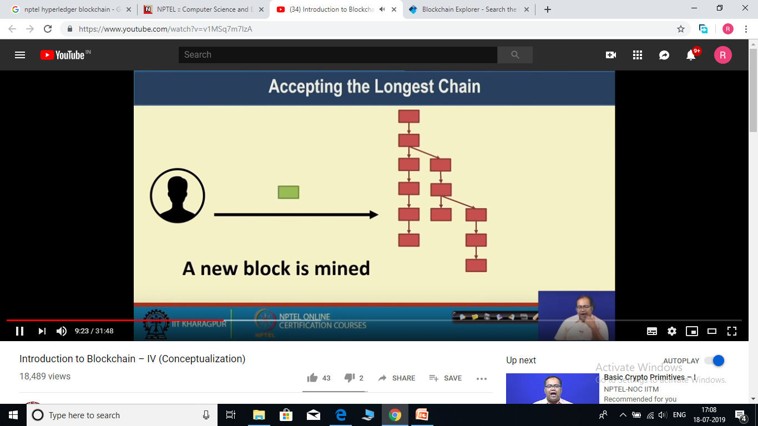
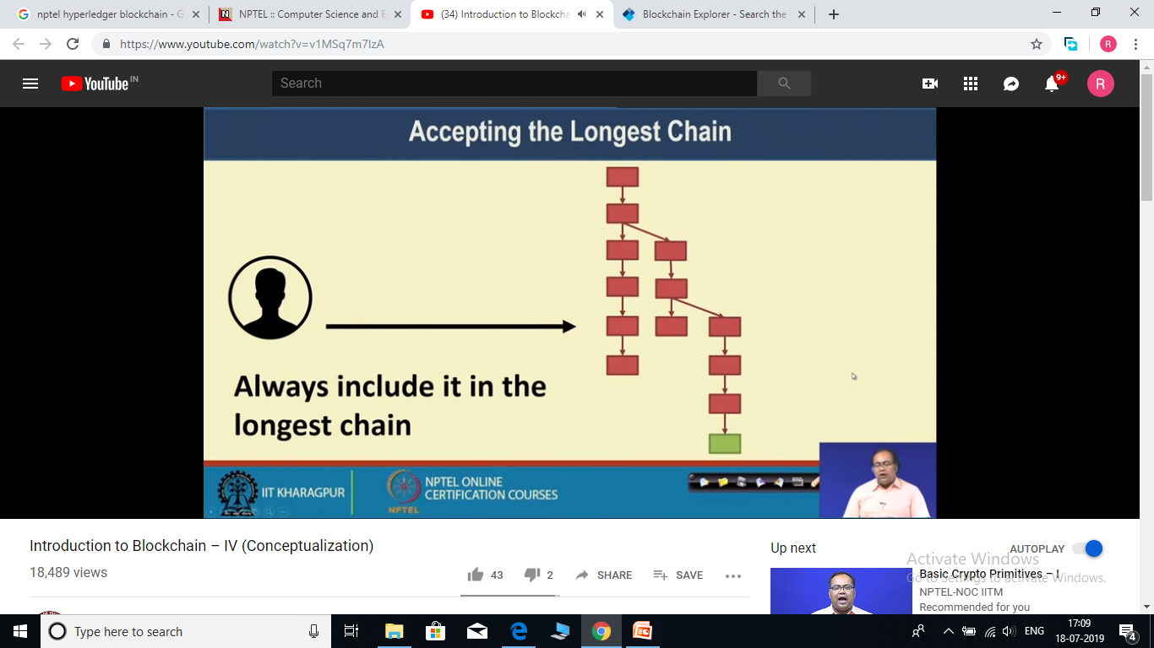
If a new block is mined during that time, it will be added to longest chain.

Slide 8
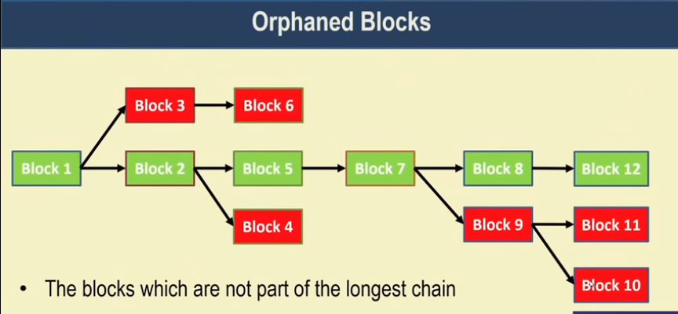

Slide 9
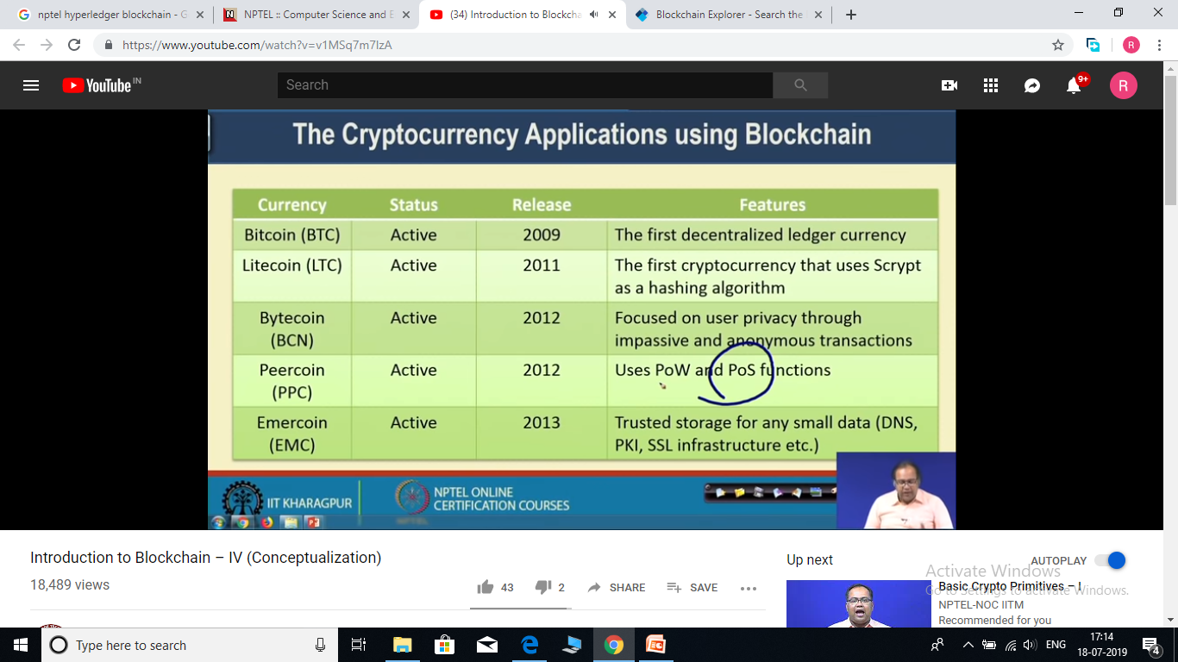
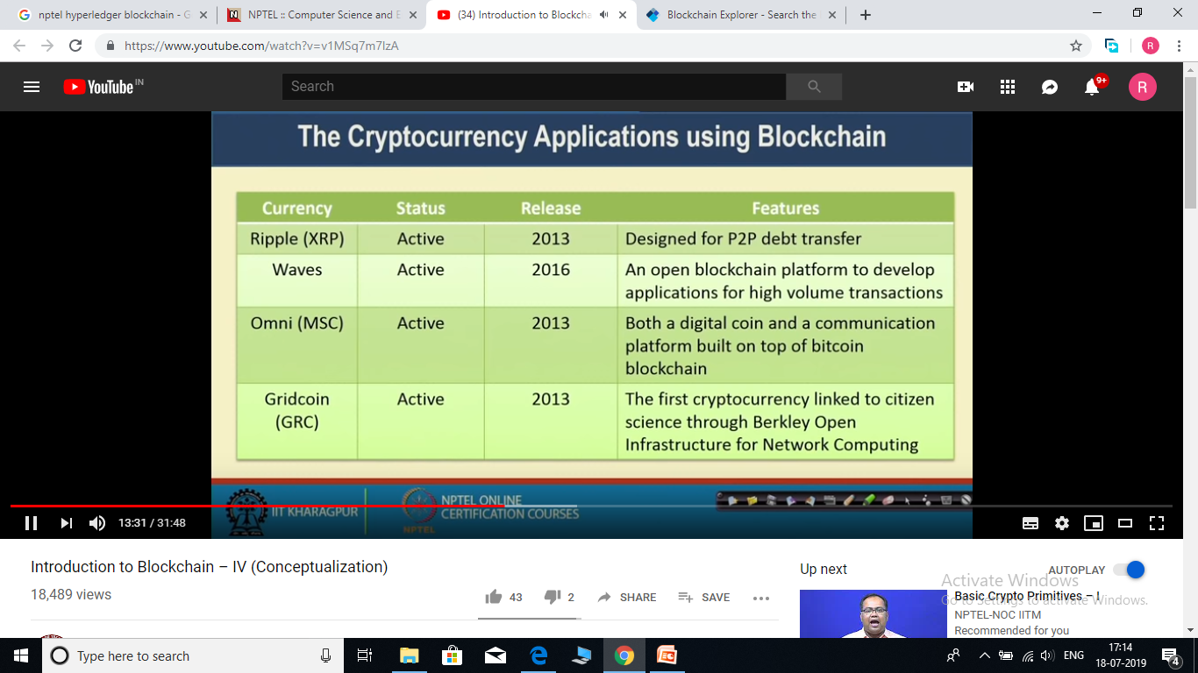

Slide 10
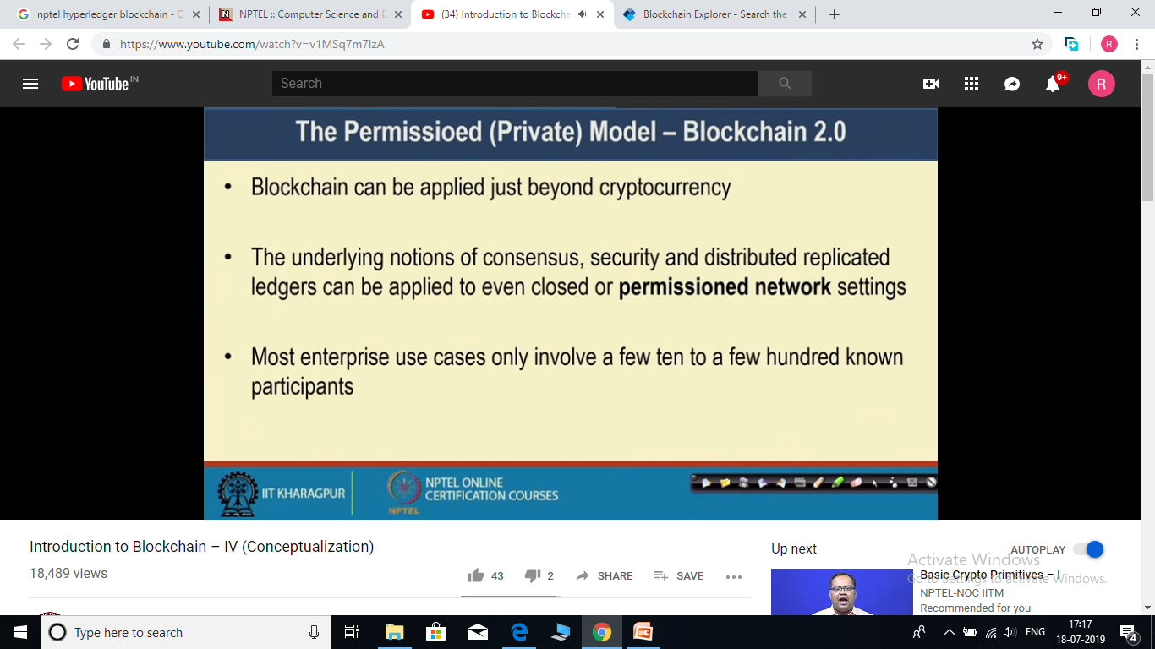

Slide 11
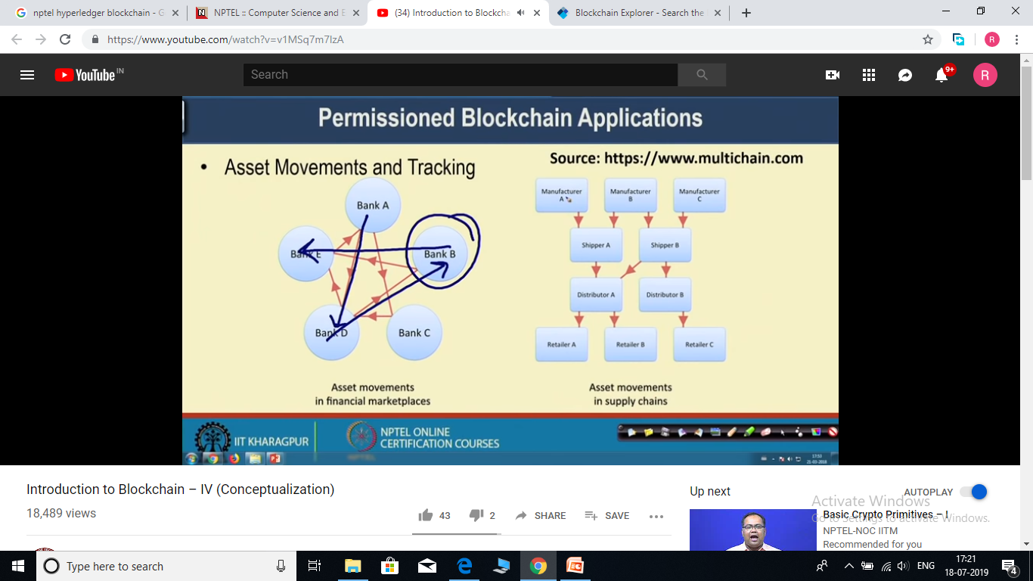
In case of bank scenario, let us suppose that you want to track the movement of any asset(money) from one bank to another bank in such a way that later on any bank cannot deny that it has not received the asset.
Same is the case with asset movement in supply chain example.

Slide 12
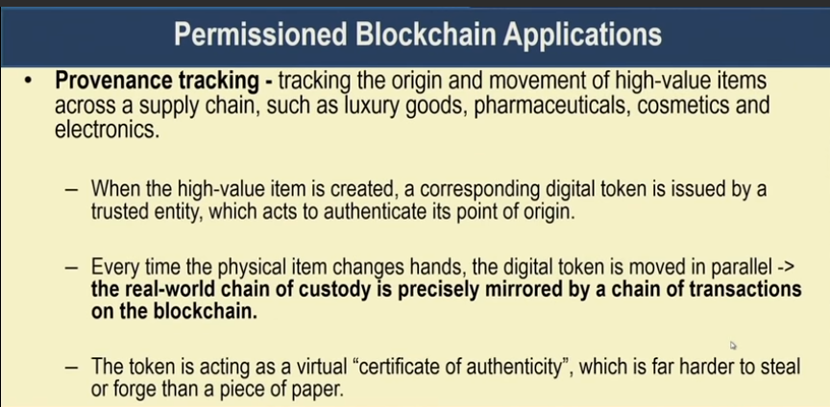

Slide 13
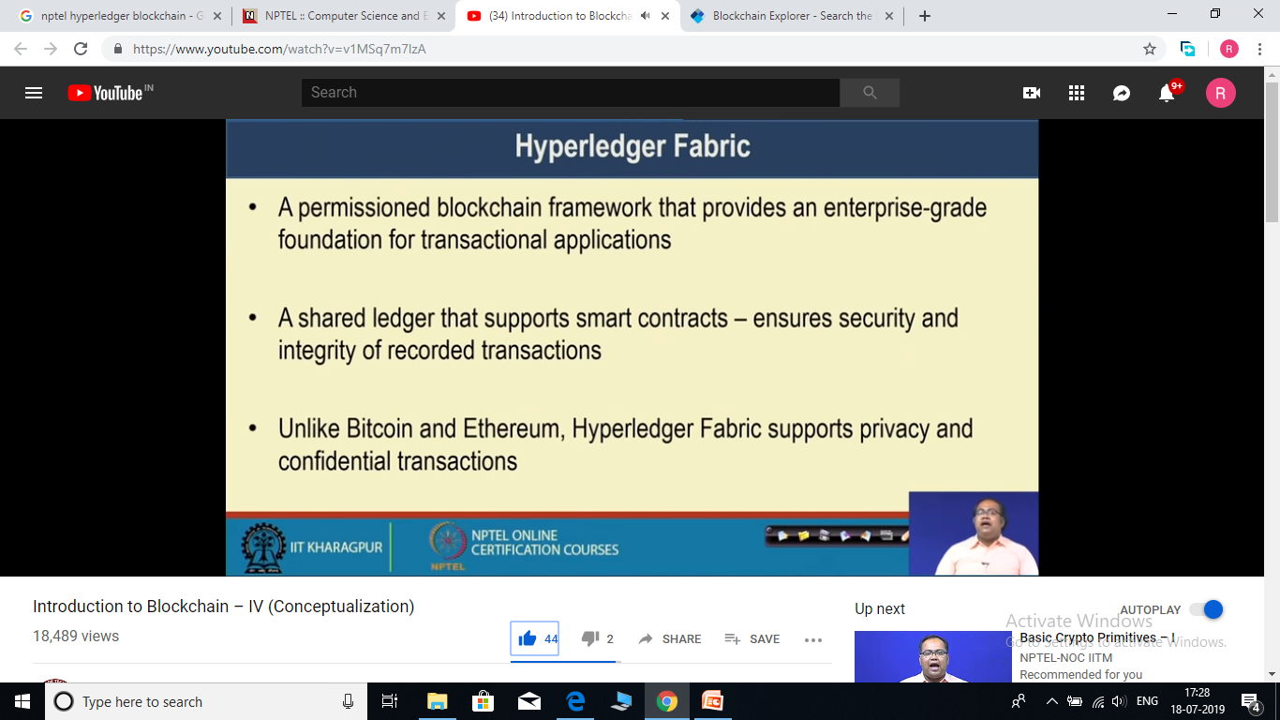
Hyperledger Fabric

Slide 14
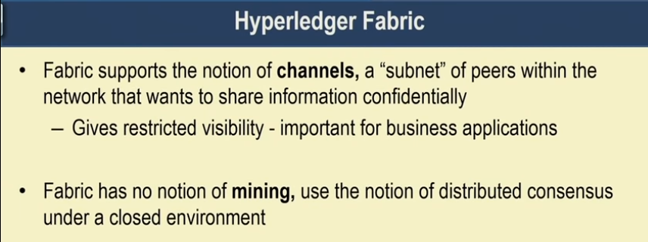
Channels -> groups of users within blockchain n/w. Through channels, Hyperledger provide different visibility of data to different channels to maintain privacy.
It makes use of standard consensus algorithm to maintain the consistency of distributed ledgers.

Slide 15
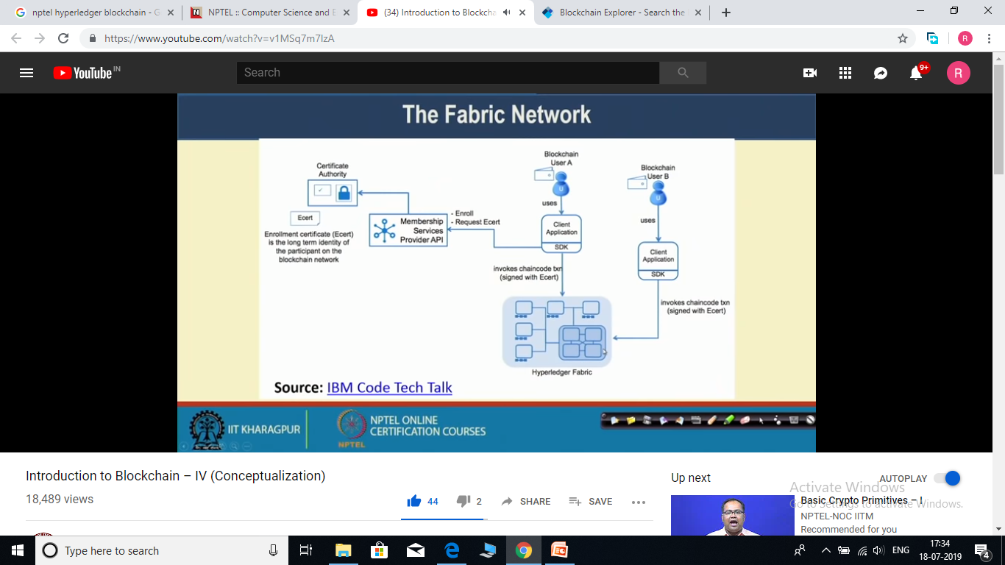

Slide 16
